Slide 1

Query Tuning without Production Data
Focusing on execution plan patterns and faking out the optimizer

Slide 2




Derik Hammer
@sqlhammer
derik@sqlhammer.com
www.sqlhammer.com
Database Administrator (Traditional/Operational/Production)
Specialize in High-Availability, Disaster Recovery, and Automation
User group leader of FairfieldPASS in Stamford, CT.

Slide 3

Notes:
** 3 min

Slide 4
Why do we tune our queries?
To meet or exceed user expectations
To efficiently use system resources
Notes:
Expectations:
1. As a user I want to click SAVE and wait no longer than 4 seconds before receiving confirmation.
2. There are 6 commands which make up the SAVE operation.
3. The sum of the elapsed time of all 6 commands must take less than 4 seconds, under the worst scenarios.
Resources:
CPU / Memory / Storage sub-system I/O

Slide 5
Goals
Answer these questions
How do I tune a query without production quantity data?
How do I tune a query without production quality hardware?
Demonstrate
How to setup your development database
Query anti-patterns to look for when tuning

Slide 6
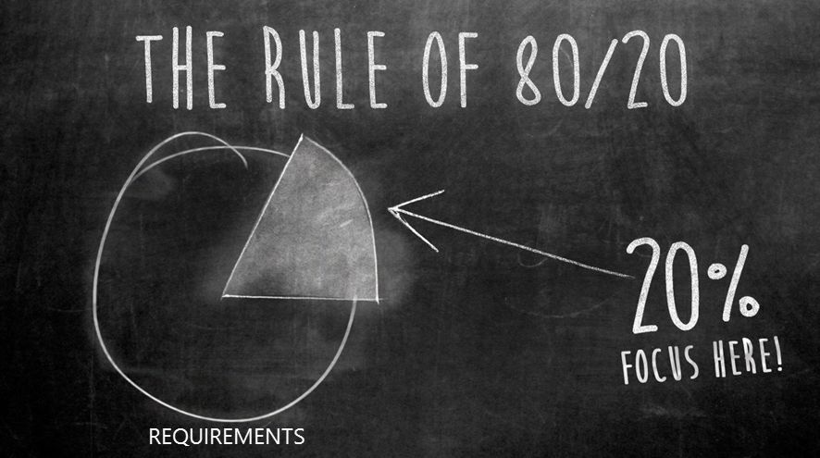
Why do this then?
Notes:
20% of the requirements for 80% of the results
You only need production data and hardware to tune the last 20% of the results but with 80% of the requirements.

Slide 7
How will we get there?
Make the optimizer think its row counts and data skew matches production.
Make the optimizer think that the hardware matches production.
Tune based on compiled execution plan instead of elapsed time / actual IO work load

Slide 8
Limitations of this method
Cannot definitively validate cardinality estimates.
Cannot tune for concurrency because a simulated work load is not possible.
Any queries executed would complete instantly because there is no data.

Slide 9
Setting up the development environment

Slide 10
The plan
Create a database which matches in schema only, no data.
An existing development database with non-production data can be used as well.
Copy statistics from production into development.
Either disable automatic statistics updates or set the database to read only mode.

Slide 11
Demonstration
Generate Scripts Vs. DBCC CLONEDATABASE
Notes:
Use your 2014 SP2 or 2016 SP1 instance.
DBCC CLONEDATABASE ('AdventureWorks2014','AdventureWorks2014_clone')
OR
Documented since 2005 > https://support.microsoft.com/en-us/kb/914288
Right-click db
Tasks
Generate scripts
Script entire db and all db objs
Advanced
Enable
ANSI Padding
Cont. scripting on err
Include system constraint names
Script bindings
Script collation
Script for whatever edt. you are using.
Scripts stats to include stats and histograms
Schema only
Triggers
Next > Next > Finish
Open script.
Modify db size of files.
Modify ALTER DATABASE [AdventureWorks2014_clone] SET READ_WRITE
Set to ALTER DATABASE [AdventureWorks2014_clone] SET READ_ONLY
Instead of step 9, you can disable auto update stats.
Modify ALTER DATABASE [AdventureWorks2014_clone] SET AUTO_UPDATE_STATISTICS ON
Set to ALTER DATABASE [AdventureWorks2014_clone] SET AUTO_UPDATE_STATISTICS OF

Slide 12
Fake hardware with DBCC OPTIMIZER_WHATIF
Hardcode values for the optimizer to work from.
Can modify:
Effective core count
Physical memory
Platform (32-bit vs. 64-bit)
Session scoped.
Undocumented DBCC command.

Slide 13
Demonstration
DBCC OPTIMIZER_WHATIF
Notes:
Walk through comments and code in 1-OPTIMIZER_WHATIF

Slide 14
Execution Plan Tuning and Anti-Patterns

Slide 15
What is an execution plan?
Pre-compiled plan of execution.
Can be viewed graphically.
Can be estimated or actual.
Is based on schema and statistics.
Notes:
For our demos the estimated plan will work because the actual results would be based on an unrealistic work load.
Tells much truth and many lies.

Slide 16
Goals of query tuning
Consume less data.
Process less data.
Process more efficiently.
Notes:
Consume less data
Indexes
Selective filters
Process less data
Less iterations over the data.
Fewer nested loops
No table spooling
Fewer rewinds
Fewer sorts
Process more efficiently
Avoid blocking operators
Hash match instead of a large sort followed by a merge join
Proper memory grants to avoid table spills

Slide 17
Sorts
ORDER BY
TOP N Sort
MERGE JOIN
Expensive operator
Needs to fit entire sort in memory grant or else it will spill to tempdb
Blocking operation

Slide 18
Blocking Operator: Sort
Notes:
Avoiding sorts satisfies the process less data and process data more efficiently tuning goals.

Slide 19
Demonstration
Sorts
Notes:
Walk through comments and code in 2-Sorts.

Slide 20
Residual Predicates
Hidden index scans.
Varying degrees of deception.
Confuses the meaning of a covering index.
Can increase storage I/O by orders of magnitude.
Can be inside:
Index seeks
MERGE JOINs
HASH MATCH joins

Slide 21
Demonstration
Residual Predicates
Notes:
Walk through comments and code in 3-ResidualPredicates.sql.

Slide 22
Compute Scalar
Used to evaluate expressions and scalar values.
A scalar value is a single value like an integer or float rather than a data structure like a tuple.
Optimizer almost always shows them as near 0 costs.
Can prevent an execution plan from going parallel.
Inline Table-Valued Functions are the exception.
Notes:
Most are inexpensive and inconsequential.
Some are rather expensive.

Slide 23
Demonstration
Compute Scalar
Notes:
Walk through comments and code in 4-Compute-Scalar.sql.

Slide 24

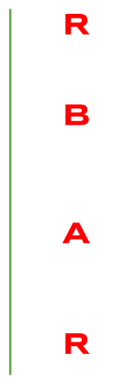



Nested Loops
Also Known As…

Slide 25
Nested Loops
RBAR: Row by agonizing row.
Look out for expensive operations on the inner loop.
SORTs
Scans
Residual Predicates
Can be caused by skewed data and parameter sniffing.
Parameter sniffing can be tested by loading data related to a couple of entities with different data sizes.
Can be caused by bad cardinality estimates.
Multi-statement table-valued functions.
Table variables.
Notes:
Great for small data sets, bad for large sets.
SQL Server is really smart but it also tries to be really fast. What do we get when an intelligent person is rushed? You get mistakes.
If you want to load some data you can take a couple of entities with different data skew.

Slide 26
Demonstration
Nested Loops
Notes:
Run through the comments on 5-Nested-Loops.sql

Slide 27
What did we learn?
No data needed
Fake it till you make it, with hardware
Learn about execution plans
Learn about parameter sniffing

Slide 28
Materials
Slide deck and demo material available at:
This deck
http://www.sqlhammer.com/presentation-query-tuning-without-production-data/
All presentations
http://www.sqlhammer.com/community/
This material has already been posted.
When I update the material, the most recent updates will be available.
My Contact Information:
@SQLHammer
derik@sqlhammer.com
www.sqlhammer.com

